Slide 1
Introduction to Hospitality (VET)
Year 10

Slide 2
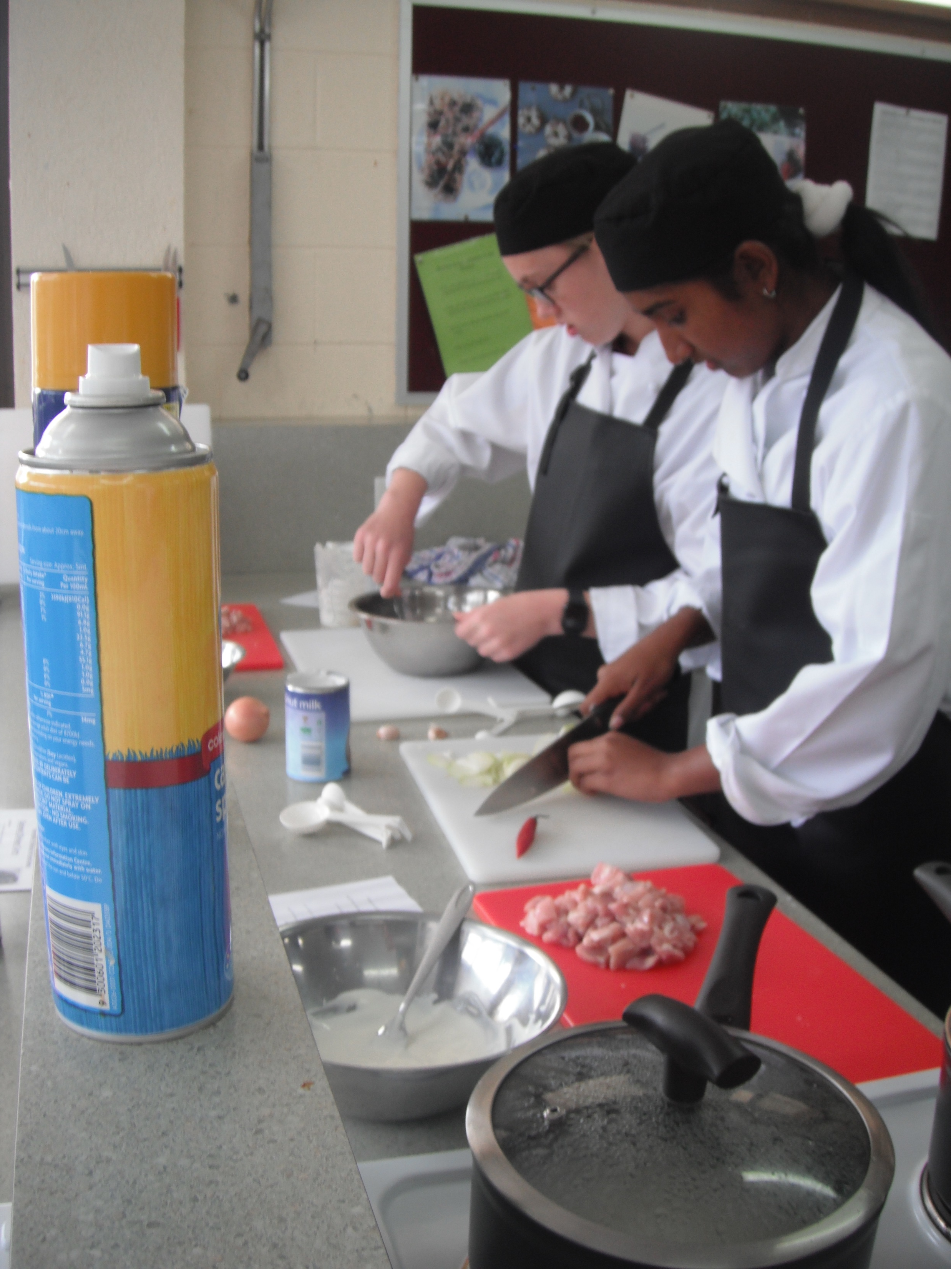
Introduction to Hospitality (VET)
Year 10 only course
Prepares students for working in the Hospitality industry
Preferred that students have taken Year 9 Food Technology previously
Chef uniforms worn every lesson
Jacket, trousers, apron, cap provided to students for the year

Slide 3
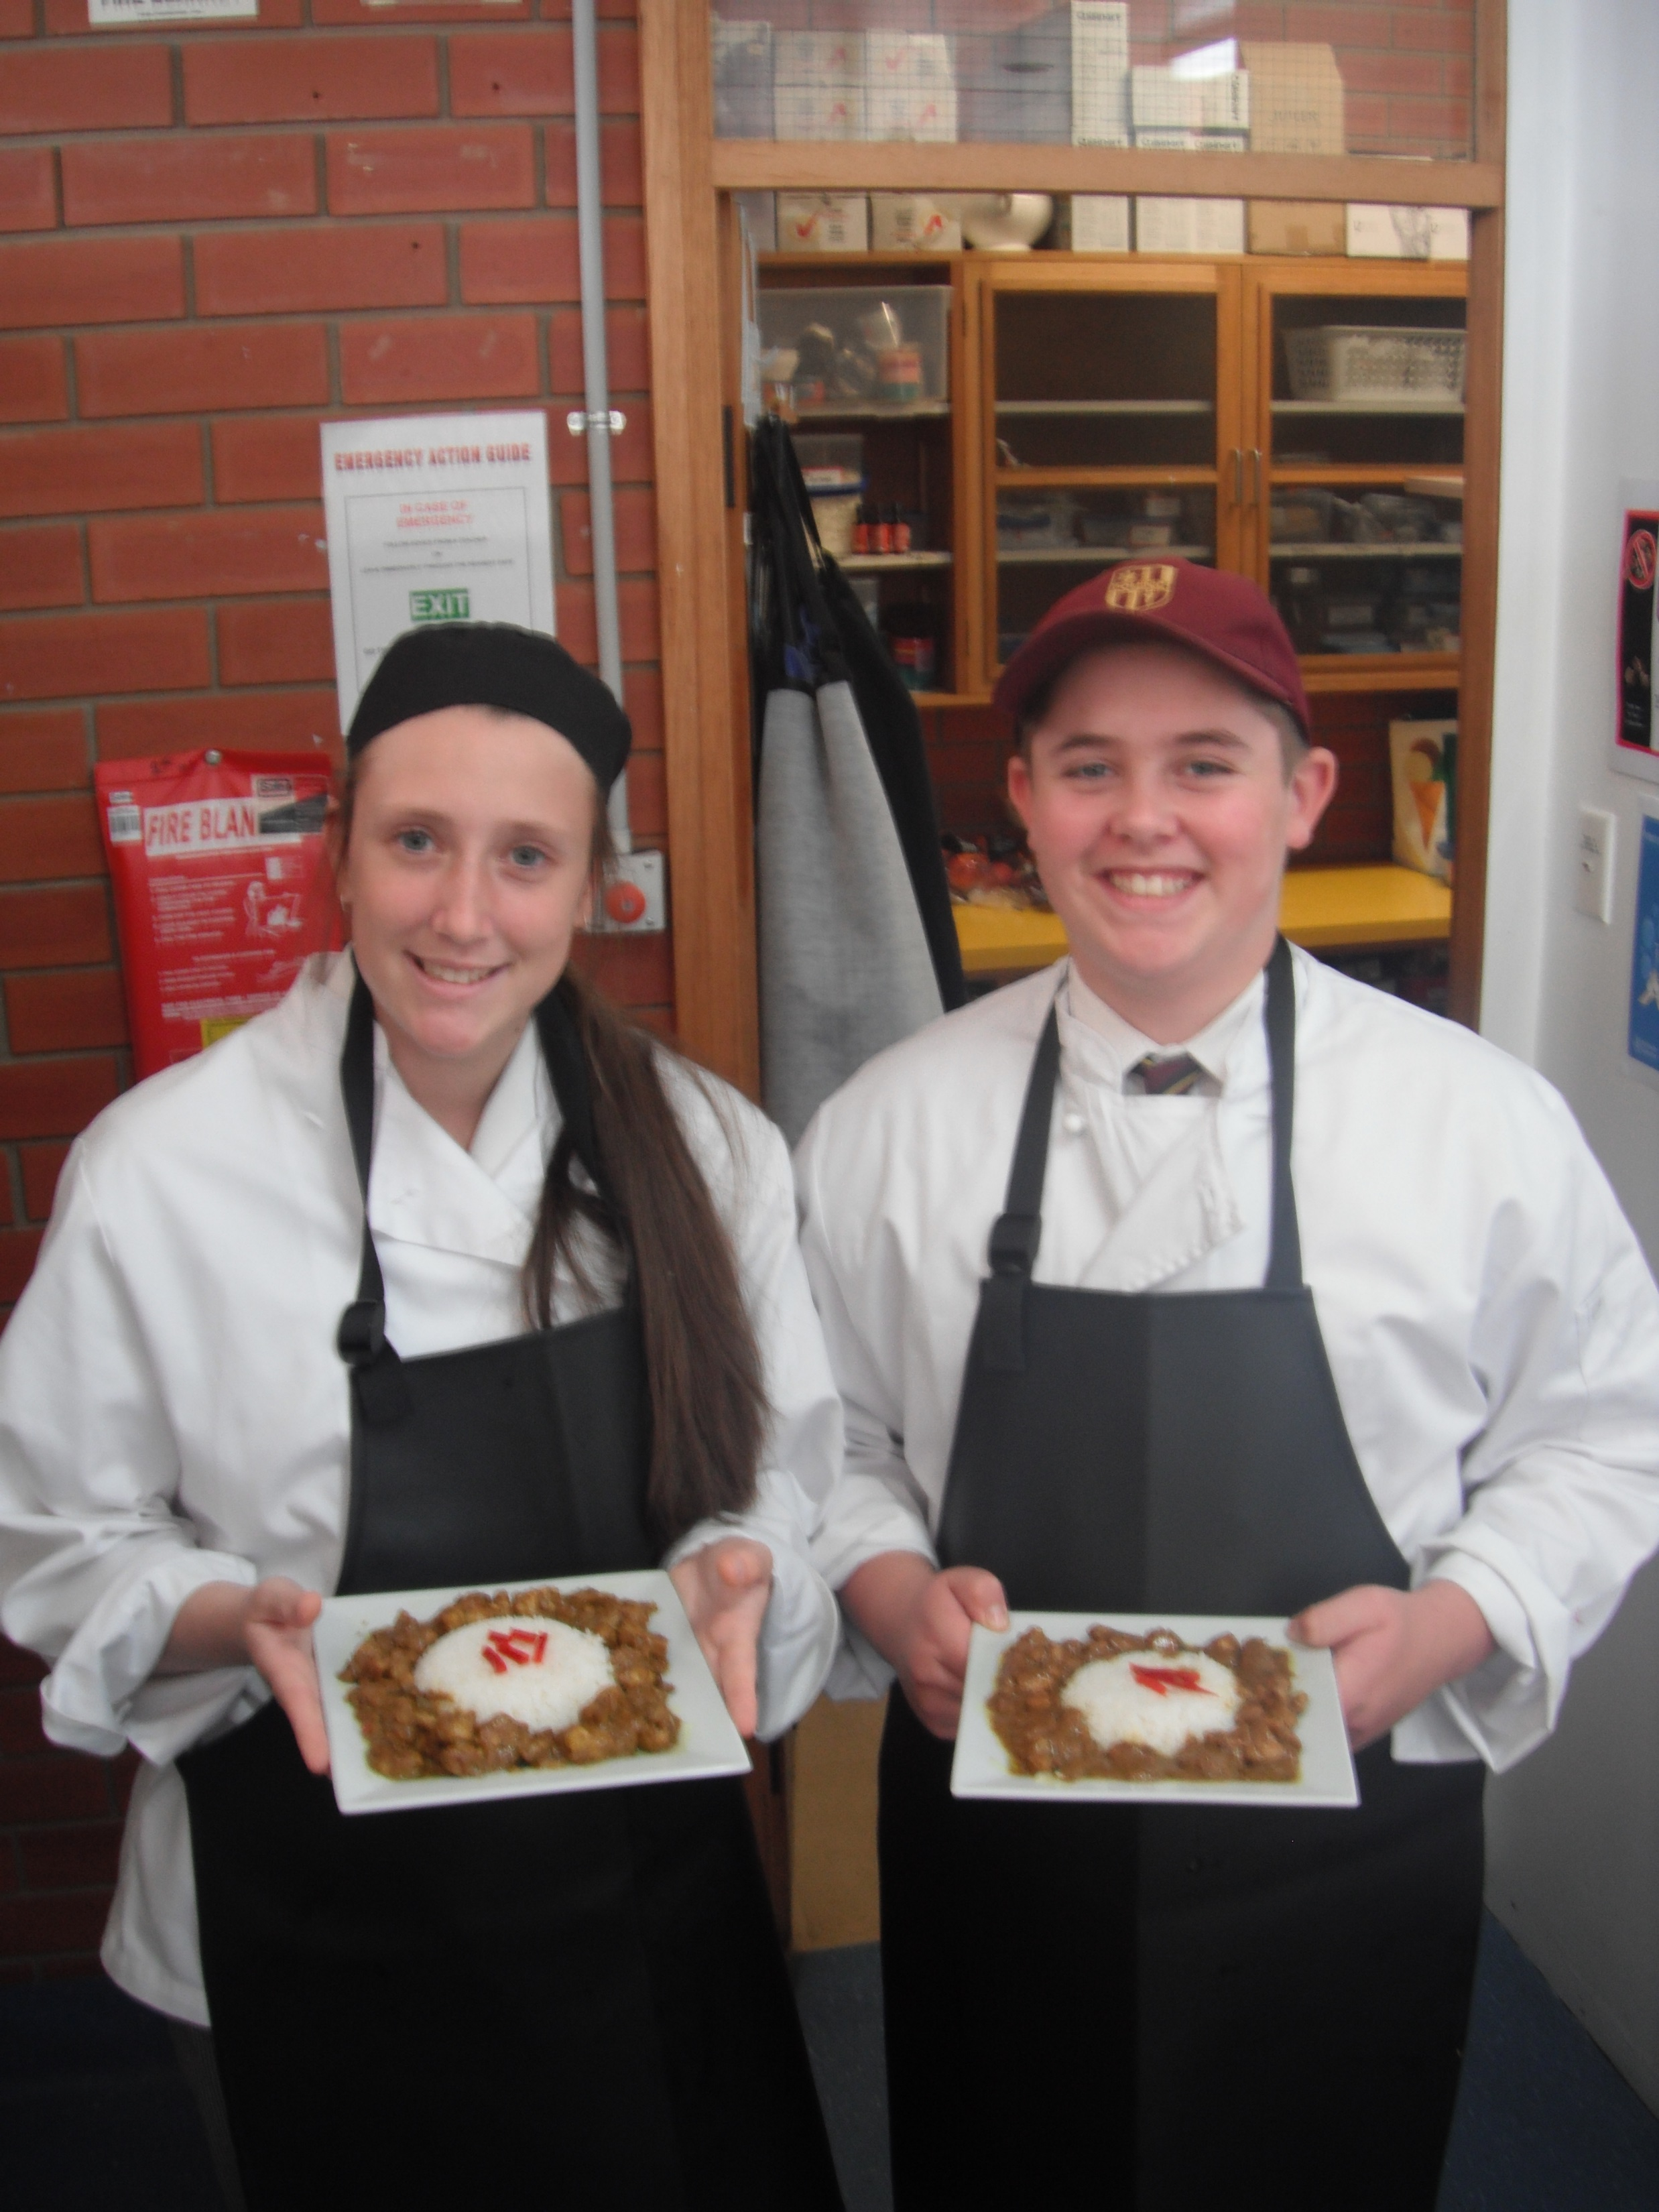
Introduction to Hospitality (VET)
Combination of theory and practical
Opportunities to cater for functions
Practical lessons in GYC commercial kitchen
Guest Chefs and master classes

Slide 4
Find out more…
Please feel free to contact Mrs Selina Kinne, Head of Technology and Applied Studies, at skinne@dominic.tas.edu.au

